Slide 1
R Language
Compiled by Muhammad Faizan

Slide 2
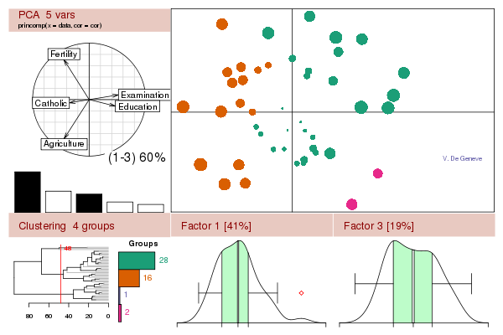
R Introduction
GNU Project Developed by John Chambers @ Bell Lab
Free software environment for statistical computing and graphics
Functional programming language written primarily in C, Fortran

Slide 3
R Technical Introduction
R is functional programming language
R is an interpreted language
R is object oriented-language
R works in an environment level

Slide 4
R Downloadable links
Two sources to get R-environment
R-Project
R-Studio (Preferred)

Slide 5
Why we R?
For Statistical Analysis
For Data Visualization
For Mathematical Functions and modeling

Slide 6
Getting Started
We will work as we go
Declaring a variable
> x = 11
> print(x)
> y <- 11
> X // Error
You can use ‘=‘ , ‘<-’ or ‘->’ to assign a variable

Slide 7
Check your variables
You can see it in workspace section
Or use the following command > ls()
To remove a variable from Workspace memory
> rm(x)

Slide 8
Variable name rule
Object name can use characters, numbers or period
But number may not occur first, you can use period as first character, but then you can expect it to be skipped when you call ‘>ls’ command
a
.a
a.1
1a

Slide 9
String
> string = “notice double quote”
> string <- ‘it works with single quote too’

Slide 10
Numeric Operations
> a + a
> x – y
> m / n
> x^2
> log(2)
> sqrt(y)
> exp(z)
> log2(1024)
> abs(-10)

Slide 11
Vectors and operation
> v_number = c(1,2,3,4,5)
> v_gender = c(‘male’ , ‘female’)
> seq ( from = 1, to = 10, by = 1)
> rep ( 1, times =10)
> rep ( 1:3, times = 2)

Slide 12
Vectors Operation & Extraction
> x = seq(from =1 , to=10, by=2)
> y = seq ( from = 2, to 10, by=2)
> x + y
> x[1] # To extract first element
> x[-1] # To extract all except first element
> x[1:3] # To extract 1st three elements
> x[c(1,3)] # To extract 1st and 3rd element
> y[ y < 6 ] # To extract element less than 6

Slide 13
Matrix
> m_seq1 = matrix(1:9 , nrow=3, byrow =TRUE)
> m_seq2 = matrix(1:9 , nrow=3, byrow =FALSE)

Slide 14
Reading Data
> read.csv (file=“~/Dataset/titanic.csv” , header=TRUE, sep=‘,’)
> read.csv2 (file=“~/Dataset/titanic.csv” , header=T)
> read.csv2 (file.choose() , header=TRUE)
> read.table (file.choose() , header=TRUE, sep=‘,’)

Slide 15
Testing Data
> dim(data1) # To check dimension of data
> head(data1) # To check first 6 entries of data
> tail(data1) # To check last 6 entries of data
> data1[c(23,5,7,55), ] # To extract specific data
> name(data1) # To check field names
> attach(cap) # To make properties recognizable
> mean(Age) # To find Mean
> median (Age) # To find Median
> detach (cap) # To find Median

Slide 16
Getting Summary
You can ask for data Summary using
> summary(data)
You can also ask what values are available using levels.
> class(data$value)
> levels(data$value)
> x = c(1,0,1,0,0,0,1,1,0)
> x<- as.factor(x)
> class(x)
> summary(x)

Slide 17
If & blocks
> attach(titanic_data)
> summary(age[sex==“women”])
> # Sub setting data
> childData <- titanic_data[age==“child” & sex==“male”, ]
> detach(titanic_data)
> areWomanandchild <- titanic_data$sex == "women" & titanic_data$age == "child"
> titanic_data_with_classification <- cbind(titanic_data, areWomanandchild) #you can also use ‘rbind’ for row wise binding

Slide 18
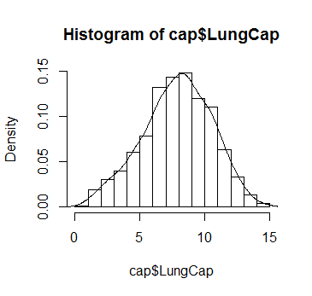
Histogram
> hist(cap$lungCap, prob =T)
> lines(density(cap$lungCap))

Slide 19
Installing and loading packages
Packages are simple modules that provides common functionalities.
Packages are open sourced as well so you can create your own and contribute
> install.packages(‘igraph’)
> library(igraph)
> help(package = igraph)

Slide 20
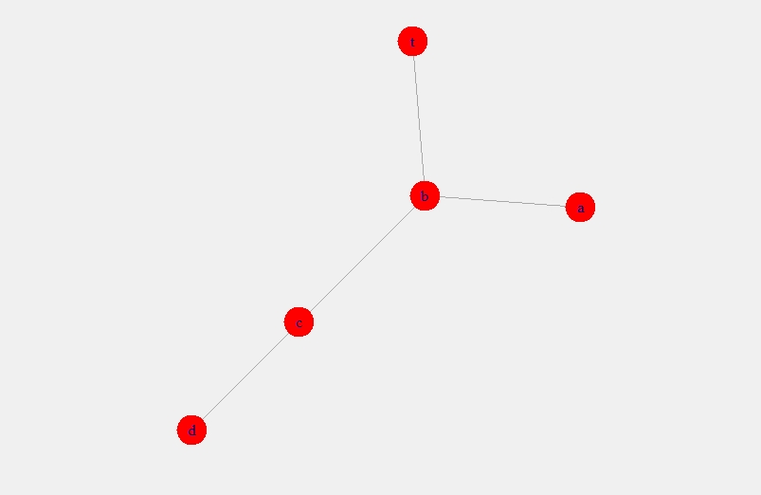
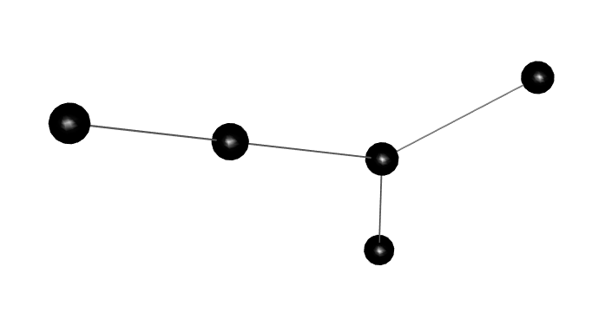
Creating A simple graph
> g.manual <- graph.formula(a—b, b—c, c—d, t—b)
> tkplot(g.manual, vertex.color=“white”, vertex.size=15)
> rglplot(g.manual)
> plot(g.manual)

Slide 21
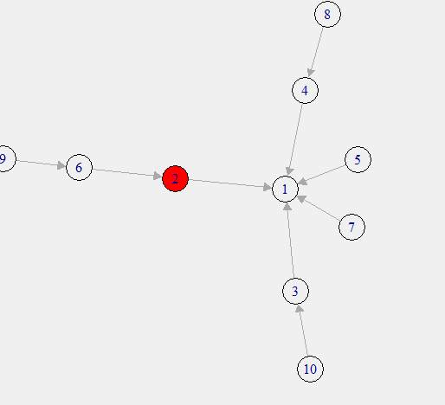
Taking out a node
> g.barabasi = barabasi.game(n=10, p = 0.5)
> V(g.barabasi)[which.max(betweenness(g.barabasi, v = V(g.barabasi)))]$color="red“
> tkplot(v.barabasi)

Slide 22
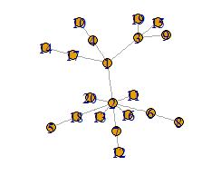
Playing more
> g.random = erdos.renyi.game(10, 0.3)
> g.mst = minimum.spanning.tree(g.random)

Slide 23
You can find
> closeness(g)
> betweenness(g)
> degree(g)
Other important commands are
> max(v)
> min(v)
> which.max(v)
> which.min(v)

Slide 24
You can Also try
Function | Description
aging.prefatt.game | Evolving graph, based on preferential attachment and aging
bipartite.random.game | Generate Bi-partite graph using random model
degree.sequence.game | Generate random graph with given degree sequence
forest.fire.game | Evolve a graph based on fire spreading phenomena
graph.adjacency | Create a graph from adjacency matrix
graph.bipartite | Creates a bi-partite graph
graph.complementer | Creates a complementary graph for a given graphs
graph.empty | Creates an empty graph

Slide 25
All Material can be found at
Github Repository for slides and data

